Slide 1

ZIP TRADING OVERSEAS AB
”we help you to make better business”
COMPANY PRESENTATION

Slide 2



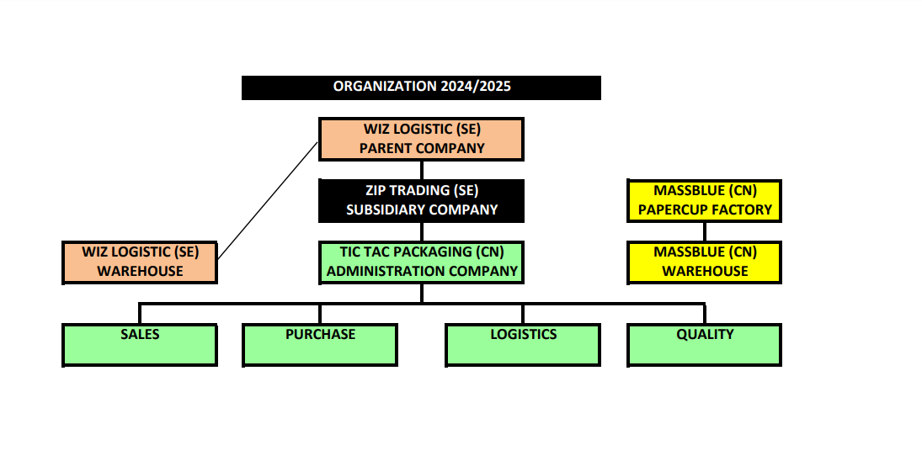
Organisation

Slide 3

Company information
Sales USD >20 million
Export >600 containers/year
Joint-venture Papercup factory in China
Office in Hangzhou, China since 2012
Established in 2002
Warehouse in China and Sweden
Management with 50 years experience

Slide 4
Business concept – Sales
Direct from manufacturers in China
to wholesalers in Scandinavia,
Iceland, Baltic States, Poland, Germany, Netherland, UK
Small, flexible and cost-effective organization, with focus on sales and
high accessibility customer support
Co-operation/partnership with a strategic choice of global and local wholesalers
- Full container
- Mixed container
- From warehouse

Slide 5
Customer/Partners
CUSTOMER/PARTNERS
125 customer
20% is partners – 80% of turnover
GEOGRAPHIC
Sweden 50%, Scandinavia 25%, Other 25%
SEGMENT
Paper 50%, Cash&Carry 20%,
Ethnical 10%, Office/Industry 7%,
Food 5%, Candy 5%, Clean 3%

Slide 6
Business concept – Purchase
Establish deep and long-term partnership
with manufacturers in China
Build up significant trade volume,
together with a limited number
of manufacturers
Focus on contacts with manufacturers,
knowledge of culture/language, logistics,
quality control, certification, research,
environmental/product development

Slide 7
Benefits
”solution of accessibility & simplicity”
- No middlemen
- Product test/reports & certificates
- Supplier 3rd part audits
- Negotiation/regularly price update
- Joint venture Paper factory
- Sourcing/Research
- Artwork/Customer print
- Quality control
- Delivery monitoring
- Optimize size of outerctn
- Product/environmental development
- Competitive seafreight rates
- Container, Mix cont or Warehouse
- Flexible Delivery/Payment terms

Slide 8
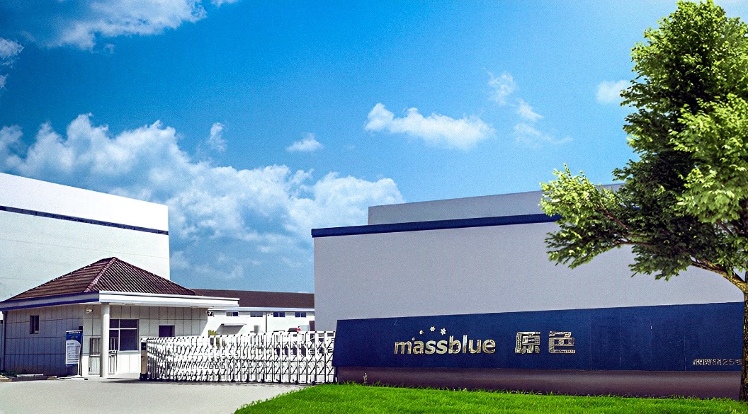
MASSBLUE
”Joint-venture Paper factory”
Located in Longyou, Zhejiang
30.000m2 land
10.000m2 factory buildings
70 machines
70 employees
Certificates: BSCI, BRC, FSC
Capacity: 1.000 cont/year
Prodution today: 600 cont/year

